Slide 1
Electrical Circuit 1 Lab(DC)
Avoid Obstacle Robot

Slide 2
Team Members:
TAMZID AHMED
MD. SHAFAYET HOSSAIN SHOHAN
REAZUL HAQUE RANA
MINHAZUL ISLAM
MD. MEHEDI HASAN
ASHRAFUL KHAN HRIDOY
SHOHANUL ISLAM SHOHAN
S.M KATIBUR RAHMAN

Slide 3
WHAT IS OBSTACLE AVOIDING ROBOT?
An Obstacle Avoidance Robot is an intelligent robot
Arduino Based Robot
Contains of a Microcontroller to process the data
Ultrasonic sensors to detect the obstacles on its path

Slide 4
MOTIVATION
Obstacle avoiding robots can be used in almost all mobile robot navigation systems.
They can be used for household work like automatic vacuum cleaning.
They can also be used in dangerous environments, where human penetration could be fatal.

Slide 5
Equipment:
Arduino Uno R3
Motor Driver Shield
Wheels (4x)
TT Gear Motor (4x)
Servo Motor
Ultrasonic Sensor
18650 Li-on Battery (2x)
18650 Battery Holder
Male and Female Jumper wire
DC Power Switch

Slide 6
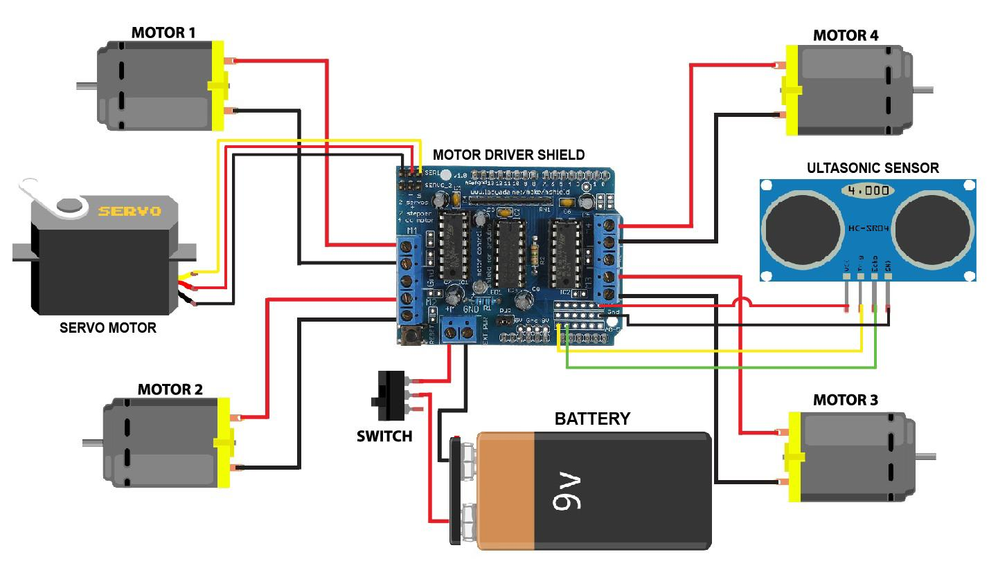
Circuit Design:

Slide 7
PROCESS:
Took a piece of PVC board 14 cm width and 9 cm length
Attach 4 motors with it
Mount Arduino over Board
Mount Motor Shield over Arduino
Attach Ultrasonic Sensor
Attach Battery Holder
Put Battery in Battery Holder

Slide 8
CONNECTION:
Connect Left Motors with Motor Shield M1 and M2 ports
Connect Right Motors with Motor Shield M3 and M4 ports
Connect Battery Holder with Motor Shield M+ and GND ports
Connect Servo Motor with Motor Shield Ser1 port
Connect Ultrasonic Sensor GND with Motor Shield GND port
Connect Ultrasonic Sensor VCC with Motor Shield 5V port
Connect Ultrasonic Sensor ECHO with Motor Shield A1 port
Connect Ultrasonic Sensor TRIG with Motor Shield A0 port

Slide 9
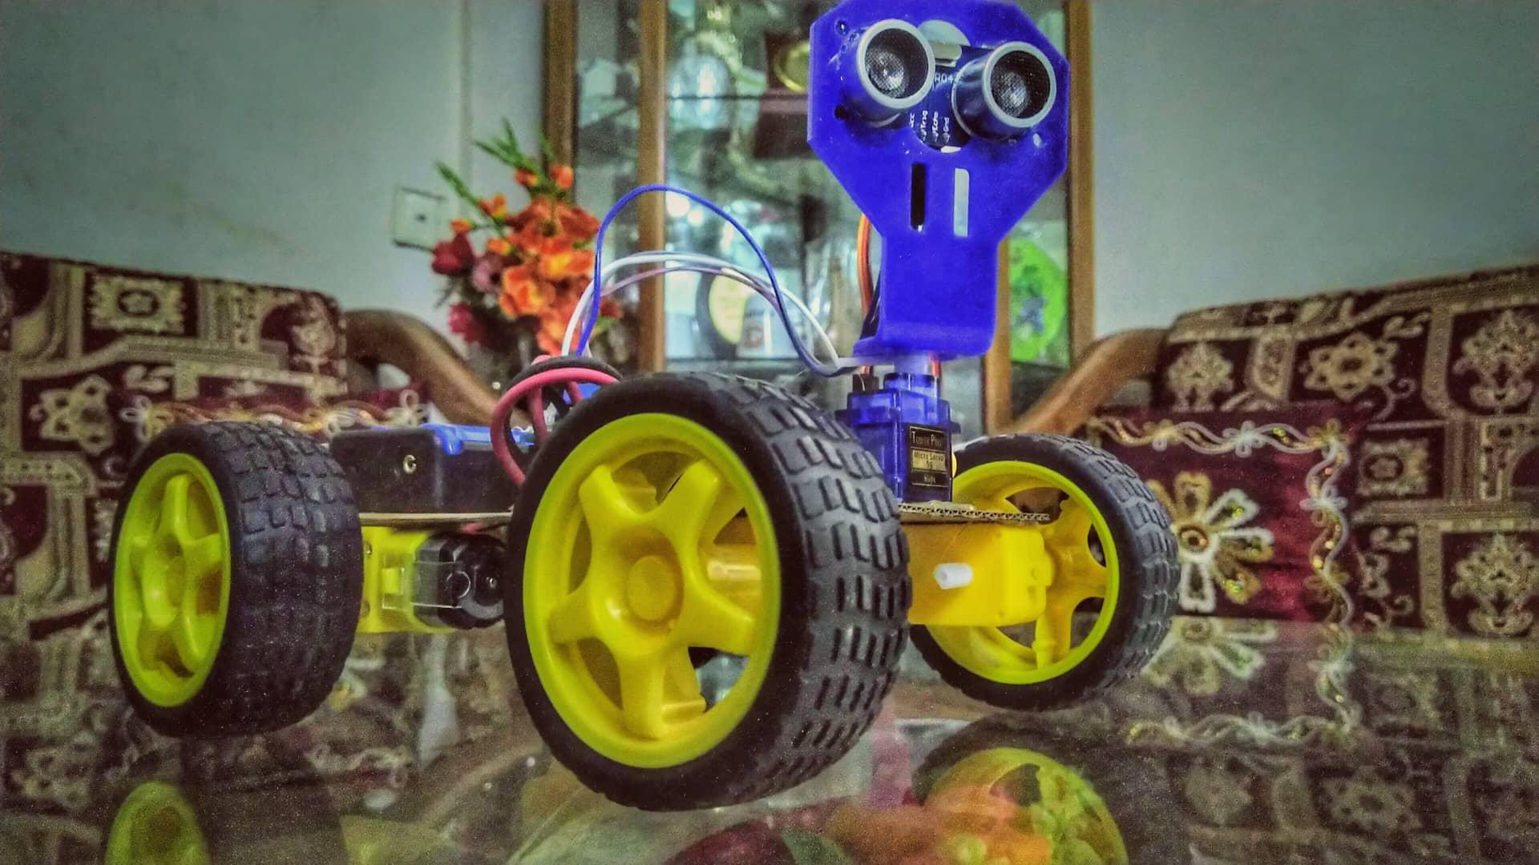
After Build:

Slide 10
Arduino Coding:
Arduino IDE
Adafruit Motor Shield Library
Arduino New Ping Library
Arduino Servo Library
CODE Link- http://www.mediafire.com/file/9b9sdwghbv105ll/ARDUINO_OBSTACLE_AVOIDING_CAR.ino/file

Slide 11
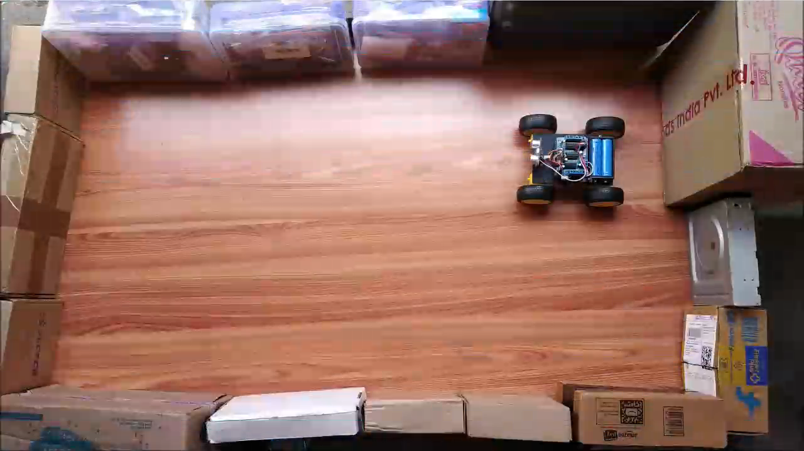
Avoiding Obstacle Robot:

Slide 12
DISCUSSION:
Rechargeable Battery is Preferable
Ultrasonic Sensor is not perfect
Use More Solid Board
Use Safety Gadgets

Slide 13
ADVANTAGES:
Reduce Accidents
Helpful for Auto Driving
Helpful for old drivers whose nerve is weak for instant reaction
Helpful for voice Control Driving

Slide 14
REFERENCE:
Arduino Official Site- https://create.arduino.cc/projecthub/chandankumarcmsn/obstacle-avoiding-robot-using-arduino-with-ultrasonic-sensor-af66f1
Electronics HUB- https://www.electronicshub.org/obstacle-avoiding-robot-arduino/
Instructables Site- https://www.instructables.com/id/Obstacle-Avoiding-Robot-Arduino-1/

Slide 15


